Slide 1

CSE 3121
Database Management Systems
Session: 2016-17
Dr. Asif Zaman
Associate Professor, CSE, RU
Week # 1

Slide 2
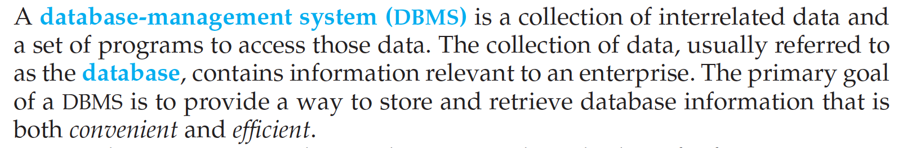
What is DBMS?
Database systems are designed to:
Manage large bodies of information.
defining structures for storage of information and
providing mechanisms for the manipulation of information.
In addition, … must ensure the safety of the information stored, despite system crashes or attempts at unauthorized access.
If data are to be shared among several users, the system must avoid possible anomalous results.

Slide 3
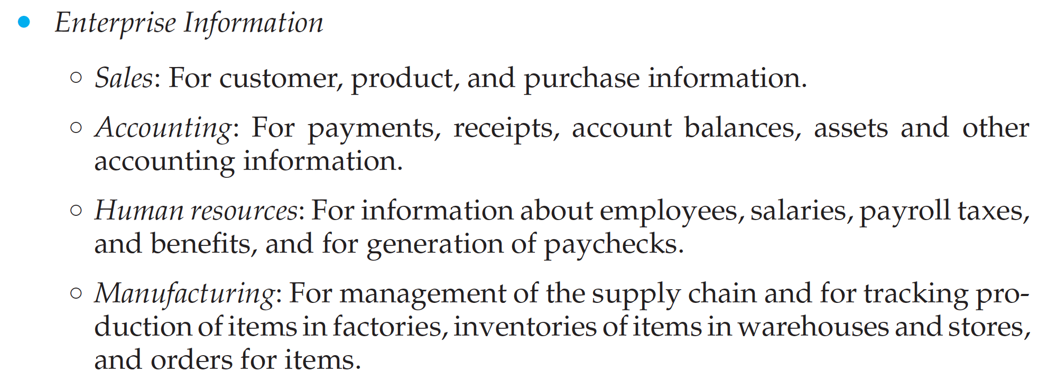
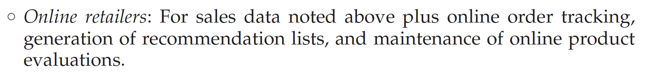
Database-System Applications

Slide 4
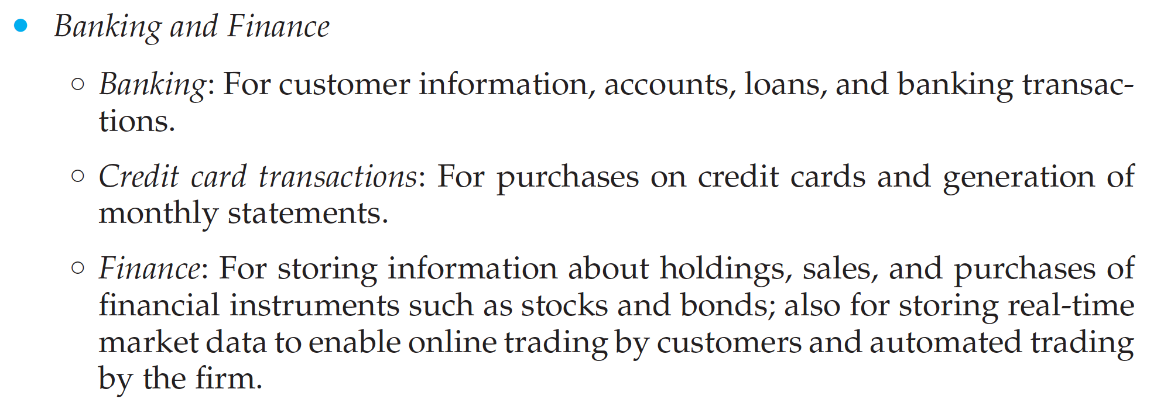
Database-System Applications

Slide 5
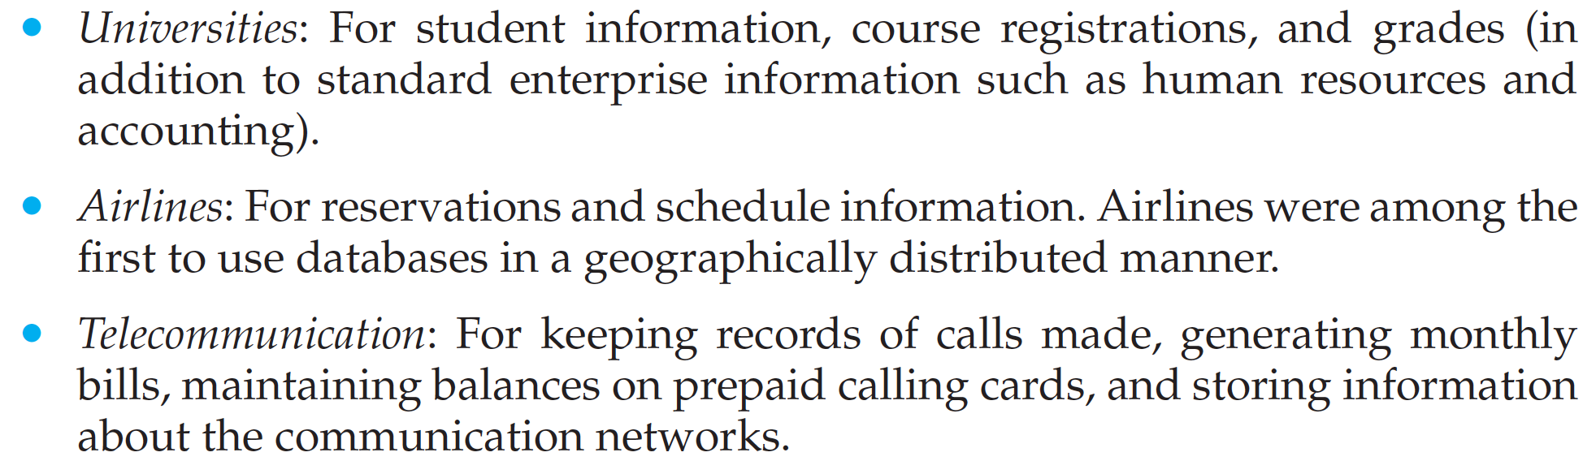
Database-System Applications
Can you explain how database systems are widely used with some representative application?

Slide 6
File-Processing System
In the early days, database applications were built directly on top of file systems, which leads to:
Data redundancy and inconsistency: data is stored in multiple file formats resulting induplication of information in different files
Difficulty in accessing data
Need to write a new program to carry out each new task
Data isolation
Multiple files and formats
Integrity problems
Integrity constraints (e.g., account balance > 0) become “buried” in program code rather than being stated explicitly
Hard to add new constraints or change existing ones

Slide 7
File-Processing System
Atomicity of updates
Failures may leave database in an inconsistent state with partial updates carried out
Example: Transfer of funds from one account to another should either complete or not happen at all
Concurrent access by multiple users
Concurrent access needed for performance
Uncontrolled concurrent accesses can lead to inconsistencies
Ex: Two people reading a balance (say 100) and updating it by withdrawing money (say 50 each) at the same time
Security problems
Hard to provide user access to some, but not all, data

Slide 8
View of Data
“A database system is a collection of interrelated data and a set of programs that allow users to access and modify these data.”
A major purpose of a database system is to provide users with an abstract view of the data.
That is, The system hides certain details of how the data are stored and maintained.

Slide 9
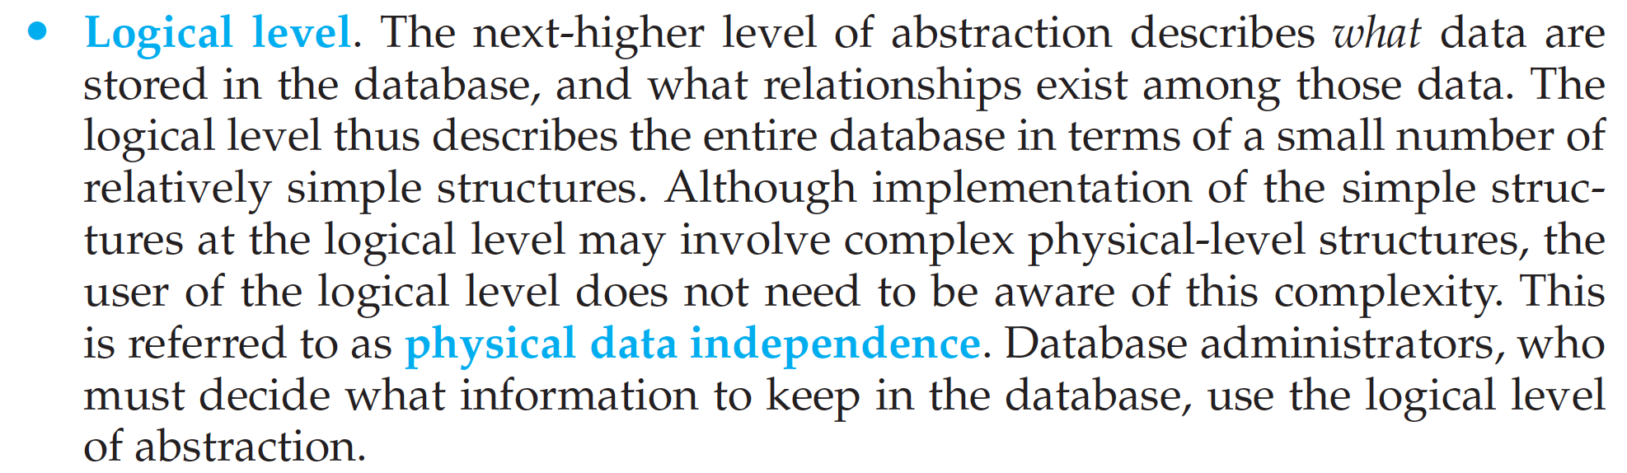
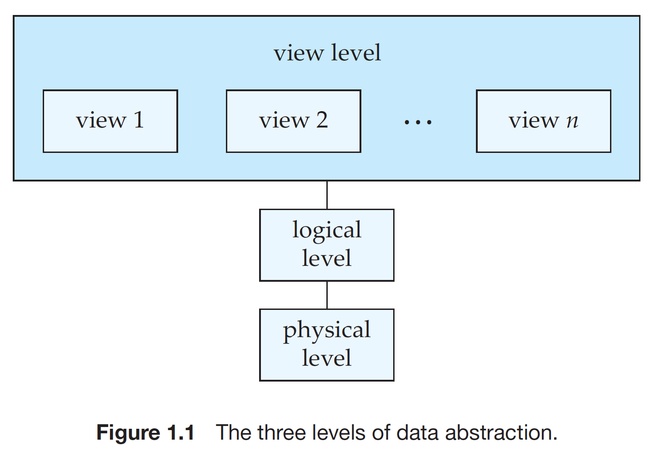
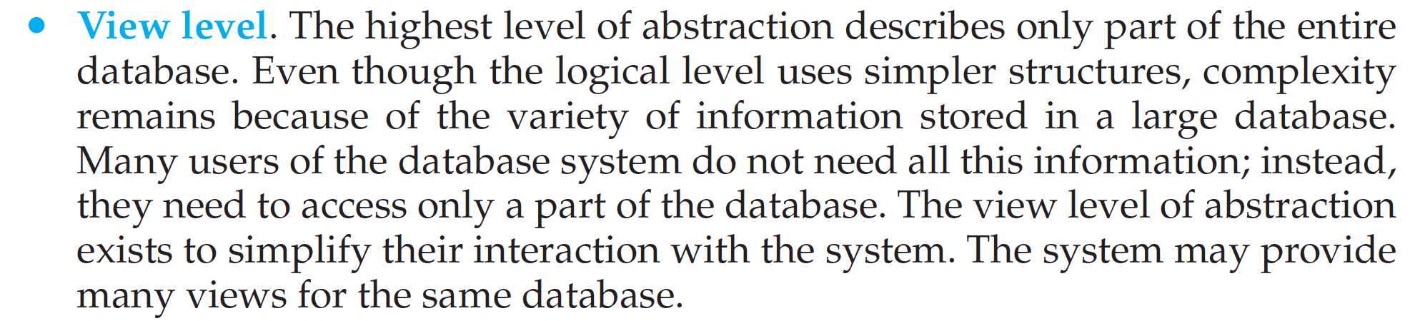
View of Data

Slide 10
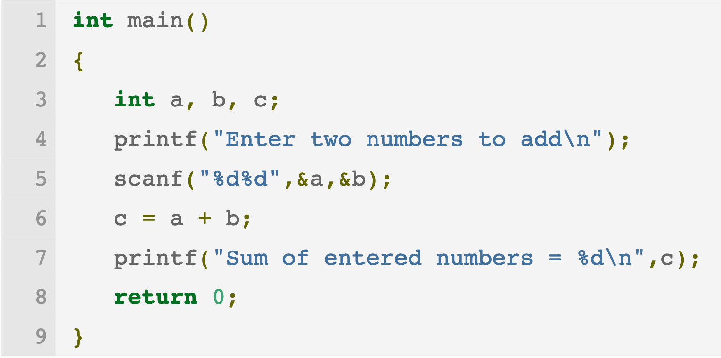
View of Data
a

Slide 11
Instances and Schemas
Databases change over time: information is inserted and deleted.
The collection of information stored in the database at a particular moment is called an instance of the database.
The overall design of the database is called the database schema.
Schemas are changed infrequently, if at all.

Slide 12
Instances and Schemas
Database systems have several schemas, partitioned according to the levels of abstraction.
The physical schema describes the database design at the physical level, while
the logical schema describes the database design at the logical level.
A database may also have several schemas at the view level, sometimes called subschemas, that describe different views of the database.

Slide 13
Data Models
Data model: a collection of conceptual tools for describing data, data relationships, data semantics, and consistency constraints.
A data model provides a way to describe the design of a database at the physical, logical, and view levels.
The data models can be classified into four different categories:
Relational Model.
Entity-Relationship Model.
Object-Based Data Model.
Semi structured Data Model.

Slide 14
Data Models
Relational Model.
The relational model uses a collection of tables to represent both data and the relationships among those data.
Each table has multiple columns, and each column has a unique name.
Tables are also known as relations.
The relational data model is the most widely used data model, and a vast majority of current database systems are based on the relational model

Slide 15

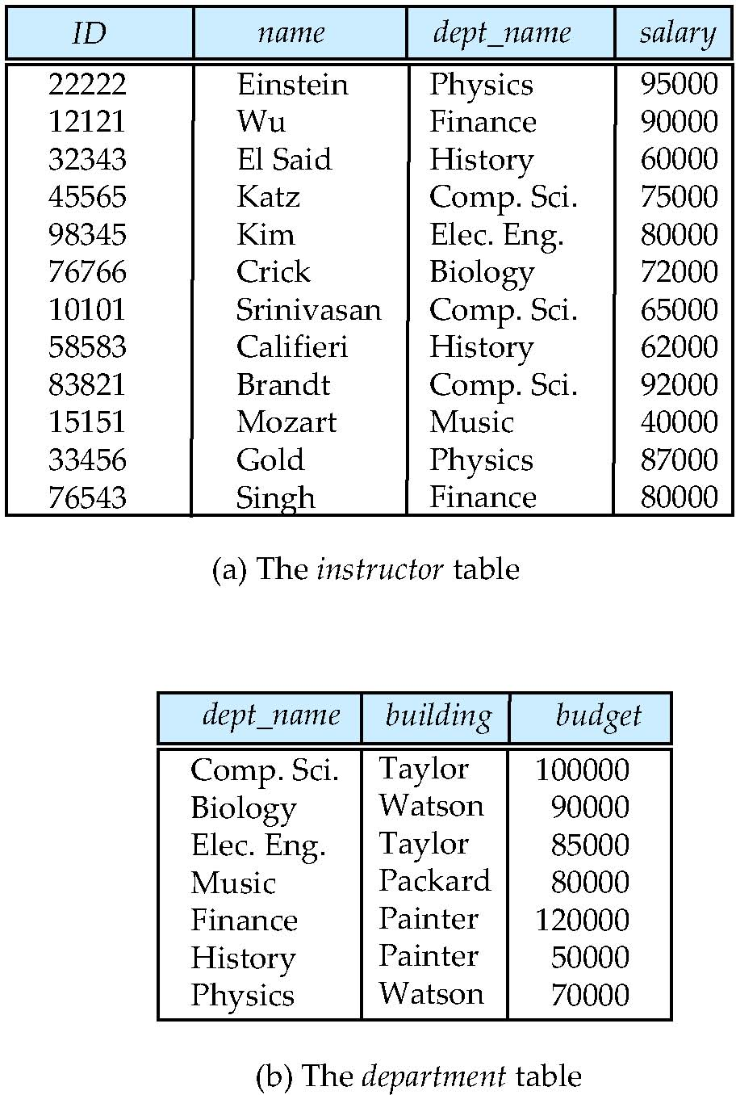
Relational Model
All the data is stored in various tables.
Example of tabular data in the relational model
Ted Codd Turing Award 1981
Columns
Rows
Notes:
15

Slide 16
